Slide 1
Muay ThAI
Overview of the IRIS-powered Muay Thai AI coach

Slide 2
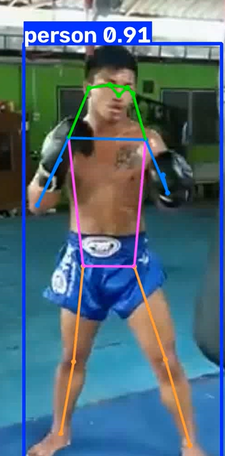
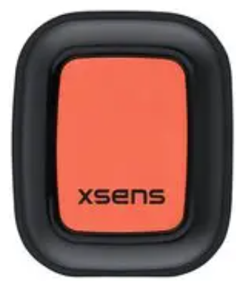
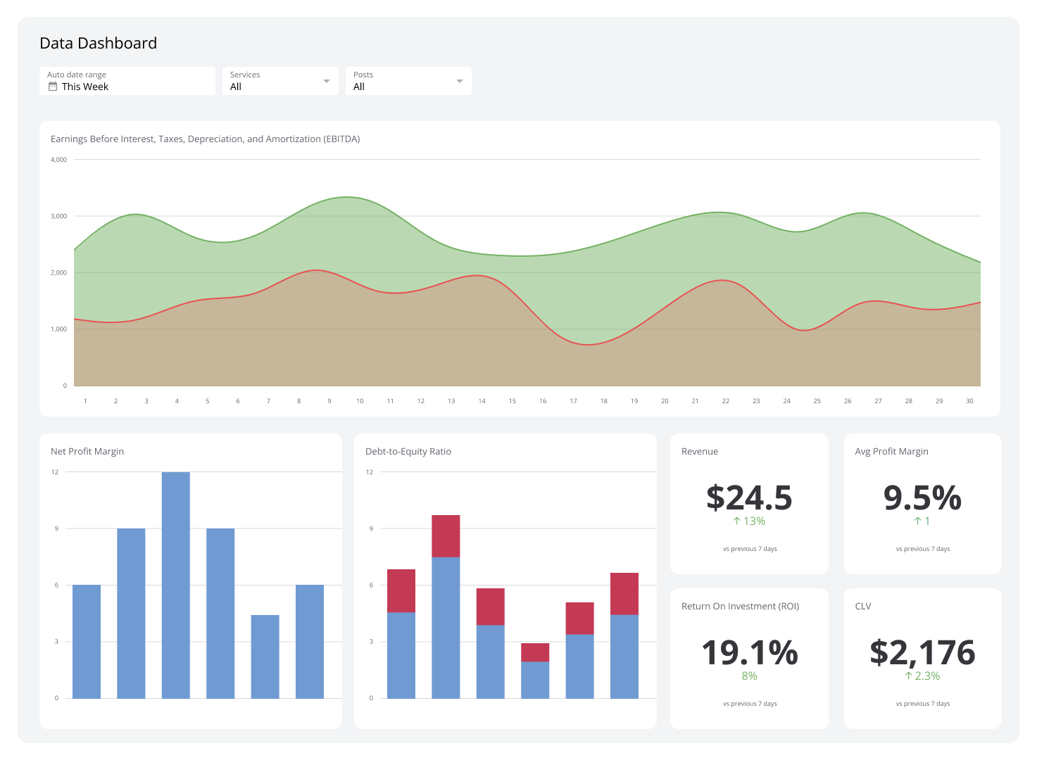


concept
Live Tracking in IRIS of:
- joints (from joint tracking)
- x5 sensor (£840) - £140 each but alone
Live Inference of:
- Guard Down: Reminder to cover
- Number of punches, kicks, elbows, knees
- Speed of punches (or wherever sensors are placed)
- KO (less priority)
User Facing:
- Dashboard with metrics
- Coach

Slide 3
IRIS showcase
Super fast ingesting , “2.5M real-time events per second”
IRIS Embedded Analytics - real-time analytics capabilities
Productions - Inbound Adaptors for sensors
Ease of Web app backend
New in IRIS 2026.1:
Integrated ML - Custom models:
SQL inference using models previously not supported (LightGBM or NNs for punch, kick, elbow, knee detection)
AI Hub:
Natural language Coach (Descriptive analytics tools and SQL query and MATCH with Integrated ML inference using SQL)
Claude Code Dev:
Features to ease web development with Claude Code. Will be used to develop front-end dashboard.

Slide 4
A single pose frame cannot reliably distinguish, for example, a punch from a hand returning to guard. The relevant information is the joint movement over time.
IMORTANT: joint movement over time
Punch: rapid wrist displacement combined with elbow extension.
Elbow: elbow displacement while the wrist remains comparatively close to the body/head.
Kick: ankle acceleration and hip rotation, usually with knee extension.
Knee: knee displacement while the ankle remains relatively close to the hip.
Guard: wrist positions relative to the nose, eyes and shoulders.
Guard should be a separate multi-label state because it can overlap with a strike.
Fine Tuning joint tracking to overcome occlusions on elbow, knee, hitting heavy bag, etc.

Slide 5
Future work
Granularity on type of strike
Roundhouse kick (ted tad), Teep
Elbow, front, round (sok)
Jab, cross, hook
Knee, front, round (kao)

Slide 6
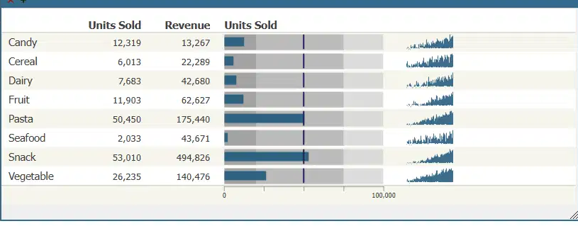
ideas
Use new embedded analytics
Display for users or whatever trends over time

Slide 7
TCN theory
TCNs are widely used in EMG (better than LSTM and GRU)
Benefits:
Better parallelism
Better control over receptive field size
More Stable gradients

